Slide 1
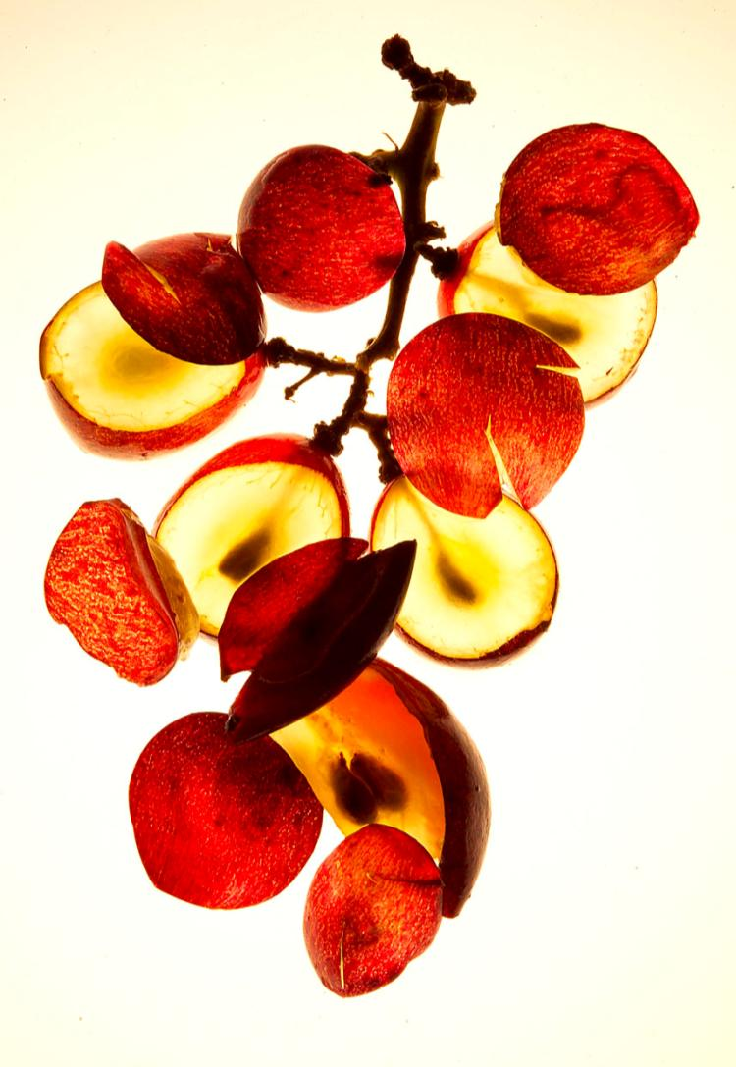
Powerful Antioxidants
For Eye and Body Health!

Slide 2
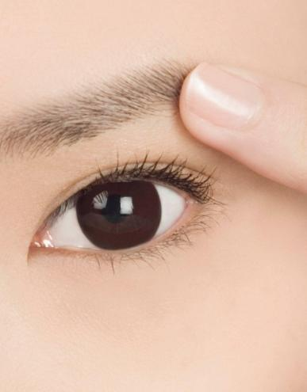
Common Aging Problems of the Eyes
Retinopathy
Deterioration of the retina, the light-sensitive, image-receiving, innermost lining of the eye, caused by damage to or overproduction of blood vessels, often through
Diabetes
High blood pressure
Chronic kidney failure
Hemorrhaging

Slide 3
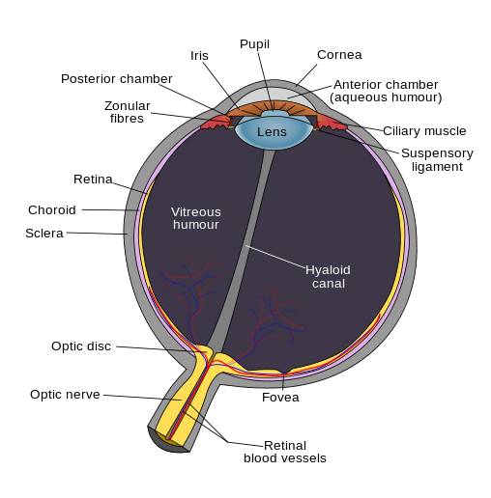
Common Aging Problems of the Eyes
Retinal Hemorrhage
Retinal hemorrhage is a serious threat to eyesight. It is a possibility whenever there is damage to the eyes or a condition affecting the blood vessels of the retina, such as diabetes or high blood pressure.

Slide 4
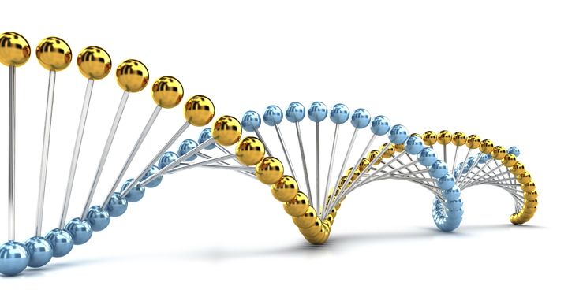
What are Free Radicals?
Free radicals are atoms that have lost an electron and become unstable. To stabilize themselves, they steal electrons from other atoms in our body, leaving damage behind.
Science believes that free radicals may be the root cause of many chronic and degenerative problems related to:
Heart health
Eye health
DNA damage
And the aging process

Slide 5
What are Free Radicals?
“[The] odd, unpaired electron in a free radical cause it to collide with other molecules so it can steal an electron from them, which changes the structure of these other molecules and causes them to also become free radicals. This can create a self perpetuating chain reaction, in which the structure of millions of molecules are affected in a matter of nanoseconds (a nanosecond is a billionth of a second), wreaking havoc with our DNA, protein molecules, enzymes and cells.“
Michael Dye, medical researcher

Slide 6
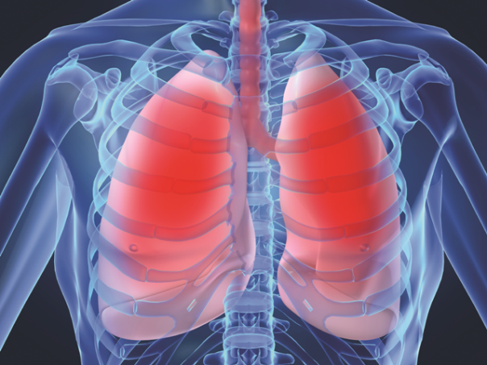
Where Do Free Radicals Come From?
They are a natural by-product of biochemical reactions in normal metabolic functions, such as breathing.
They are found in the food we eat, our water supplies, drugs and medicine and the air we breathe.
Other environmental aspects, such as radiation, pesticides, solvents, fried foods, alcohol, tobacco smoke, etc.

Slide 7
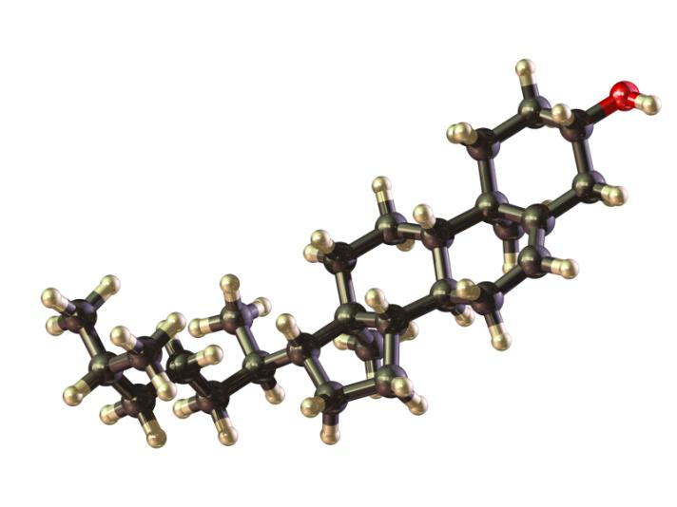
What are Antioxidants?
Antioxidants have extra electrons that allow them to donate electrons to free radicals, stopping their chain reactions and protecting our cells.
Different antioxidants have different affinities for different types of tissue.
Some may be fat soluble and others water soluble.
Some are allowed into the brain and others are not.

Slide 8
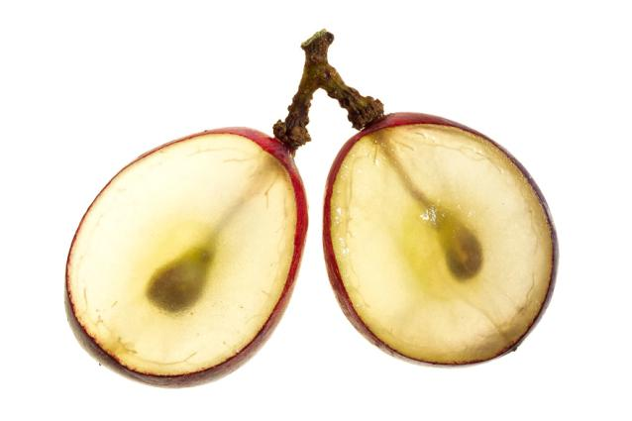
What are OPCs?
Oligomeric proanthocyanidins (OPCs) are very powerful antioxidants found in the seeds and skin of many plants.
Red grape seeds have higher and more bioavailable concentrations of OPCs than most other plant foods.
Vitamins E and C and beta carotene are also antioxidants, but studies show that the antioxidant effects of OPCs are significantly greater than from vitamins E and C or beta carotene.

Slide 9
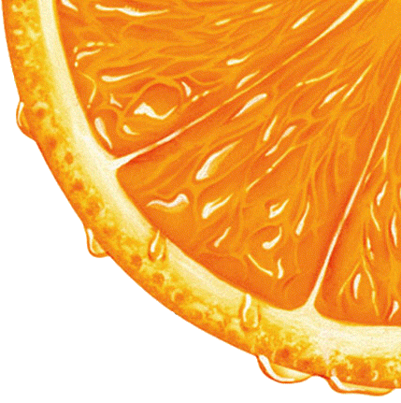
What are OPCs?
OPCs have been shown to increase the absorption of other essential vitamins, such as vitamin C.
Studies also show that, if OPCs are present, lower levels of vitamin C work as effectively as optimal levels.

Slide 10
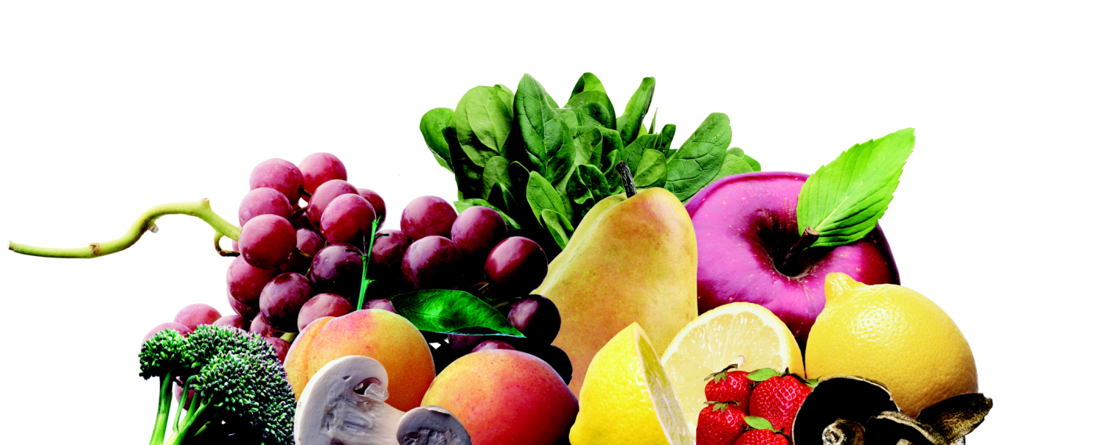
Why Whole Foods?
“People think that we can pull out the fiber, pull out the antioxidants [from whole foods]. But research does not back that up. Study after study says you gain the most benefit from whole foods.”
David Klurfeld, National Program Leader for Human Nutrition at the USDA's Agricultural Research Service.

Slide 11
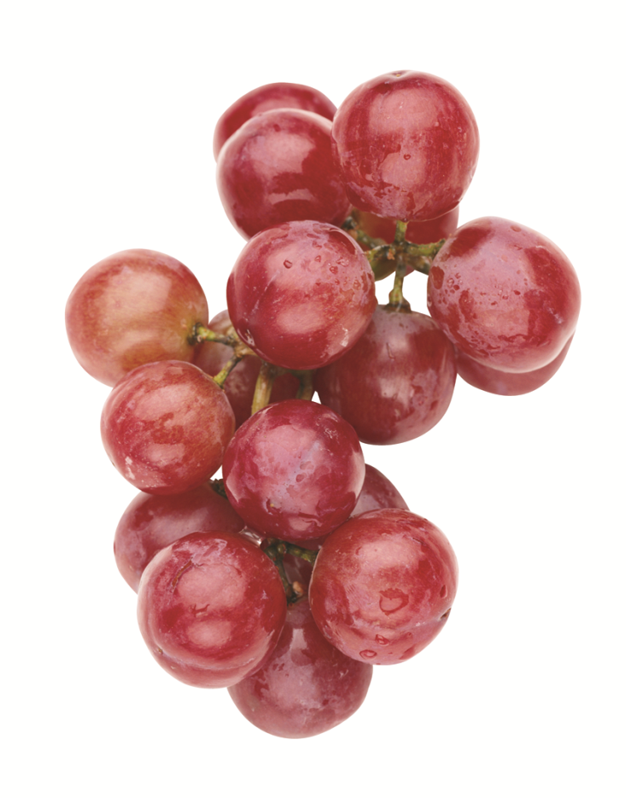
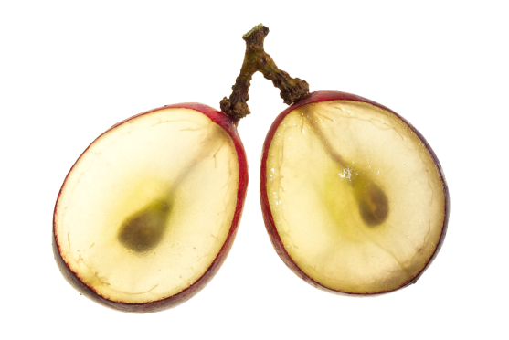
Grape Seed Extract
A water soluble grape seed extract provides the right balance of vitamins, polyphenols and naturally occurring antioxidant compounds, such as OPCs.
Studies show a broad spectrum of antioxidants is safer and more effective for long term health than a single antioxidant.

Slide 12
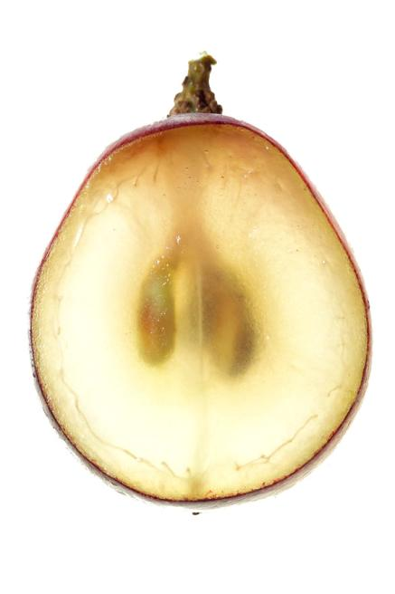
Grape Seed Extract
Studies reveal that grape seed extract may affect conditions such as high blood pressure and high cholesterol.
Phenolics in grape seeds may help reduce risk of heart disease by reducing inflammation.
Contains resveratrol, which may interfere with the growth and spread of damaged cell.
Source: http://en.wikipedia.org/wiki/Grape_seed_extract

Slide 13
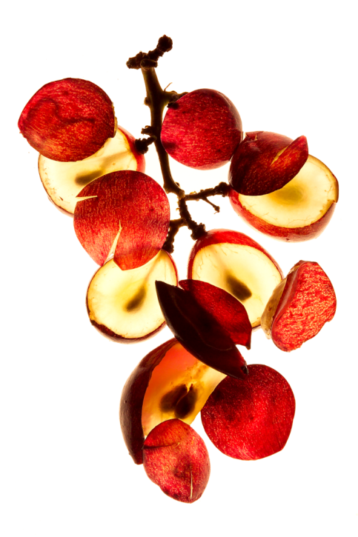
Grape Seed Extract
Preliminary research shows that grape seed extract containing OPCs may :
Assist with skin health
Retard growth of bacteria that cause dental cavities
Enhance bone density and strength
Provide supplementation for sunscreen protection
Source: http://en.wikipedia.org/wiki/Grape_seed_extract

Slide 14
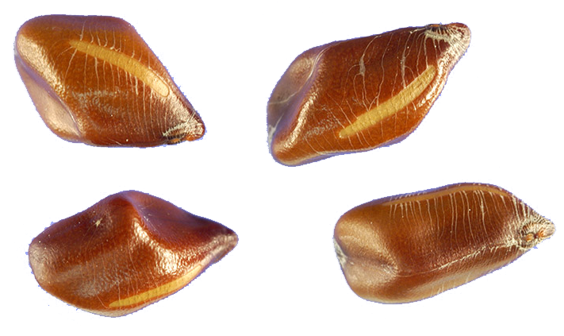
Cassia Tora Seed Extract
Called “bright eyes” by the Chinese.
Has significant liver protective benefits
Helps eliminate free radicals and other toxins from the body to help maintain eye health.
Source: http://www.buzzle.com/articles/cassia-seed-extract-benefits.html

Slide 15
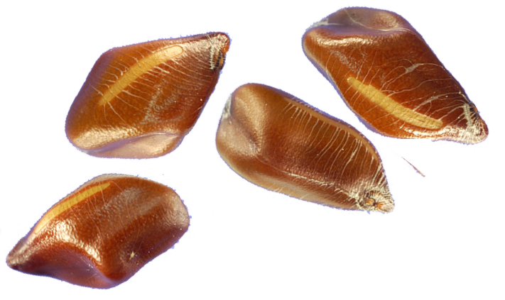
Cassia Tora Seed Extract
Tonic for the eyes, kidney, liver and bowel. Helps the liver function better by improving lipid metabolism and cleansing toxins.
Contains anthraquinones, which have laxative properties.
Contains retinoic acid, which helps support eye health, including bloodshot eyes
Source: http://www.buzzle.com/articles/cassia-seed-extract-benefits.html

Slide 16
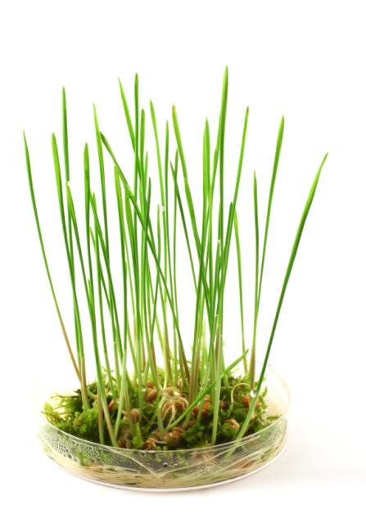
Barley Leaf
Rich in beta-carotene, calcium, iron, vitamin C, and chlorophyll
Contains potassium, phosphorus, magnesium and other minerals in substantial quantities
Contains vitamins B₁ , B₂ , B₆ , pantothenic acid, and folic acid.
Contains the antioxidant enzyme superoxide dismutase and nitrogen reductase
Source: http://www.drugs.com/npp/barley-grass.html

Slide 17
Barley Leaf
Studies show blood levels of oxygen- free radicals were reduced by supplementation with 15 g/day barley leaf extract in patients with type 2 diabetes.
LDL oxidation was increased in studies after supplementation with barley leaf extract.
Source: http://www.drugs.com/npp/barley-grass.html

Slide 18
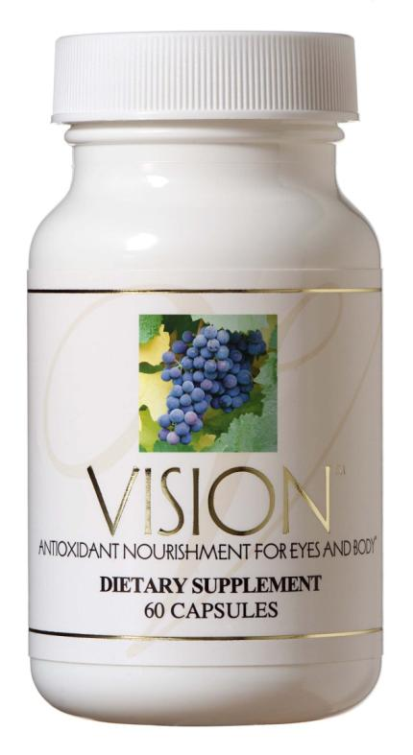
VISION™
Grape Seed Extract
Cassia Tora Seed Extract
Barley Leaf

Slide 19
VISION™
Helps defend the cardiovascular and nervous systems from free radical damage
Supports the function of the eyes
Enhances liver function
Helps cleanse damaging toxins from the liver

Slide 20
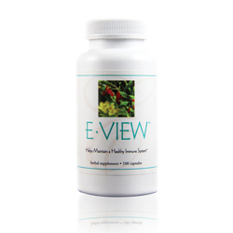
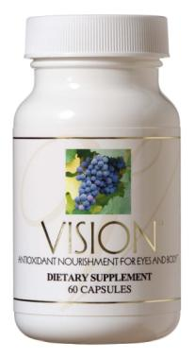
Product Combinations
+
Vision™
E-View™

Slide 21
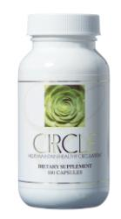
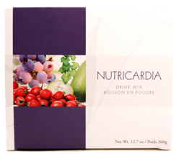
Product Combinations
+
+
Vision™
Circle™
Nutricardia™

Slide 22
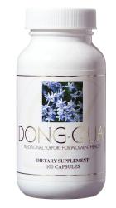
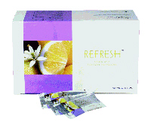
Product Combinations
+
+
Vision™
Dong Quai
Refresh™

Slide 23
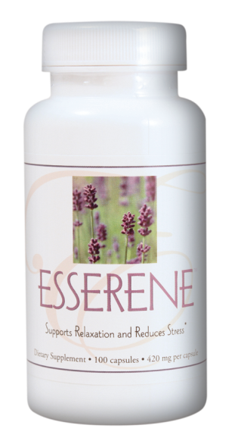
Product Combinations
+
Vision™
Esserene™

Slide 24
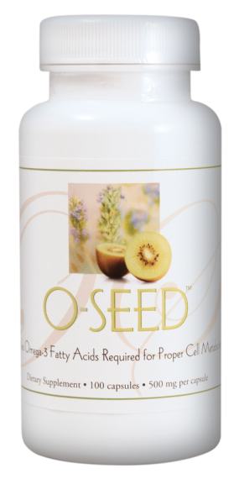
Product Combinations
+
Vision™
O-Seed™

Slide 25
E. EXCEL Products are Different!
We use a wide variety of whole plant foods!
We use whole foods because they are healthier than isolated single vitamins or minerals!
We formulate our products to be rich in micronutrients! (phytochemicals, polysaccharides and antioxidants)
We never use stimulants or unhealthy plants!
We have a wide variety of products based on the wisdom and science of Nutritional Immunology.
Make a difference in your nutrition with E. EXCEL!

